Slide 1
7.1
Object Oriented Development Life Cycle
Unit 7
Object-Oriented Analysis & Design
7.2
The Unified Modeling Language
7.3
Use- Case Modeling
7.4
Object Modeling: Class Diagrams
7.5
Dynamic Modeling: State Diagrams
7.6
Dynamic Modeling: Sequence Diagrams

Slide 2
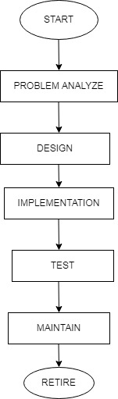
Object Oriented Development Life Cycle
Procedure of identifying software requirement and developing software specification in terms of software system's object model, which comprises of interacting objects.
Analysis : This phase involves the preparation of precise and correct modeling of the real-world problems.
System Design : It determines all system architecture, concurrent task and data storage.
Object Design : It is concerned with classification of objects into different classes and about attributes and necessary operation needed.
Implementation : It is the process of converting prepared designed into software.
Testing : It is process to test the software using object-oriented paradigms like, encapsulation, inheritance, etc.
Maintain : Customer monitors the software to ensure it continues to operate according to the coding specifications.
Fig : Object oriented development life cycle

Slide 3

Primary Task in OOA
Object identification
System object and their characteristics and events are identified.
Object Organization
Shows how objects are related via part of relationship.
Define
Define objects behavior and intervals
Object interfaces
Show how objects interact with other objects.

Slide 4
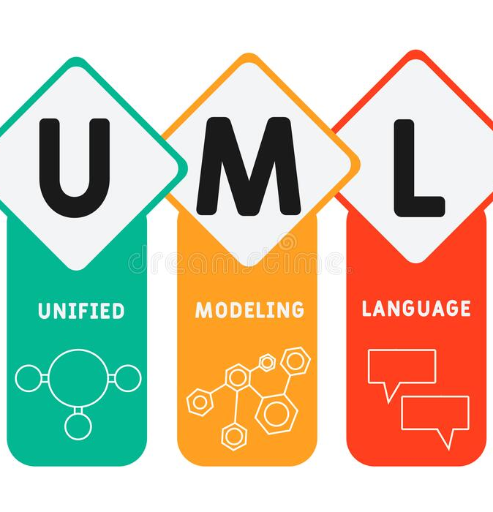
Unified Modeling Language
UML (Unified Modeling Language) is a standard notation for the modeling of real-world objects as a first step in developing an object-oriented design methodology.
It is quite similar to blueprints used in other fields of engineering. UML is not a programming language; it is rather a visual language.
UML is with the purpose of visually representing a system along with its main actors, roles, actions, artifacts or classes, in order to better understand, alter, maintain, or document information about the system.
Fig : Unified Modeling Language

Slide 5
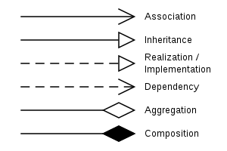
UML notation
Fig : UML notation

Slide 6
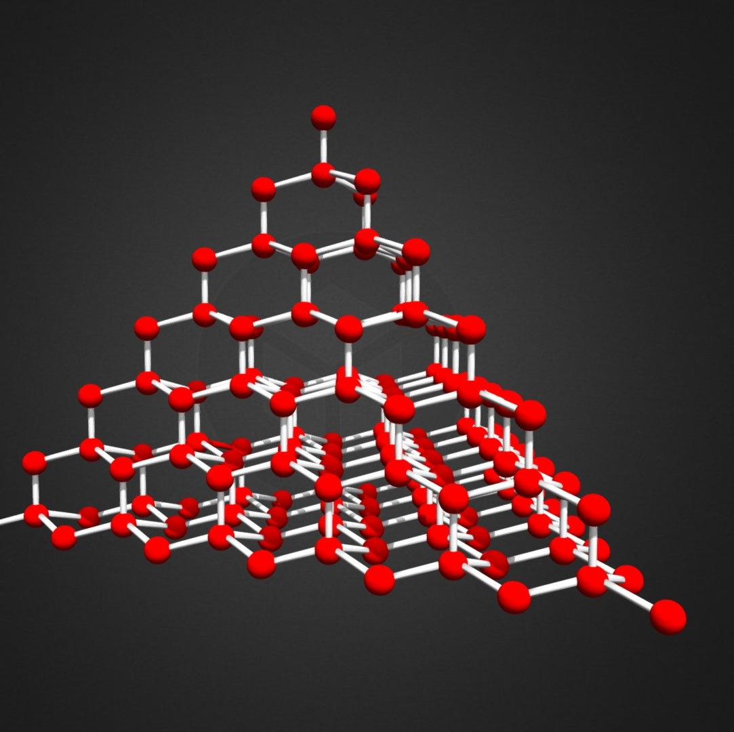
Types of UML modeling
Structured Modeling
Structural modeling captures the static features of a system. They consist of the following −
Classes diagrams
Objects diagrams
Deployment diagrams
Package diagrams
Composite structure diagram
Component diagram
Fig : Structured Modeling

Slide 7

Behavioral Modeling
Behavioral model describes the interaction in the system. It represents the interaction among the structural diagrams. Behavioral modeling shows the dynamic nature of the system. They consist of the following −
Activity diagrams
Interaction diagrams
Use case diagrams
Fig : Behavioral Modeling

Slide 8

Use Case Modeling

Slide 9
What is use case modeling?
The Use-case model is defined as a model which is used to show how users interact with the system in order to solve a problem.
A use case model describes the system from a user’s point of view. The use case model focuses on what the system does instead of how the system does.

Slide 10
Components of use case modeling
1.Systems
2. Actors
3. Use case
4. Relationships

Slide 11
System
A system is whatever you are developing. It could be a website, software component, a business process, application etc.
A system is represented by a rectangle box.
The name of the system is written on the top inside the rectangle box.

Slide 12
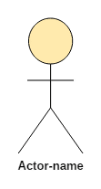
Actors
. Actor in a use case diagram is any entity that performs a role in one given system. This could be a person, organization or an external system and usually drawn like skeleton shown below.
An actors are always place outside of the system i.e outside of the rectangle box.
There are two types of actors:
a. Primary Actor
b. Secondary Actor

Slide 13
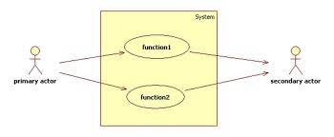
Primary and secondary actor in a use case
Primary Actor: a user whose defined user goal and is fulfilled by the system. It is always placed left side of the system.
Secondary Actors: a user who provides a service (e.g., information) to the system. It is placed at the right side of the system.

Slide 14
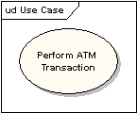
Use Case
Importance of Use Case Diagrams
To identify functions and how roles interact with them – The primary purpose of use case diagrams.
For a high-level view of the system – Especially useful when presenting to managers or stakeholders. You can highlight the roles that interact with the system and the functionality provided by the system without going deep into inner workings of the system.
To identify internal and external factors – This might sound simple but in large complex projects a system can be identified as an external role in another use case.
A use case represents an action that accomplishes some sort of task within the system. It’s drawn in an oval shaped and named with the function.

Slide 15
Relationships
There can be 5 relationship types in a use case diagram.
Association between actor and use case
Generalization of an actor
Extend between two use cases
Include between two use cases
Generalization of a use case

Slide 16
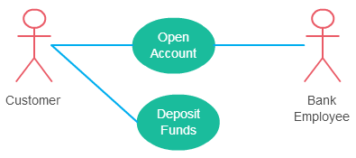
Association Between Actor and Use Case
This one is straightforward and present in every use case diagram. Few things to note.
An actor must be associated with at least one use case.
An actor can be associated with multiple use cases.
Multiple actors can be associated with a single use case.
Different ways association relationship appears in use case diagrams

Slide 17
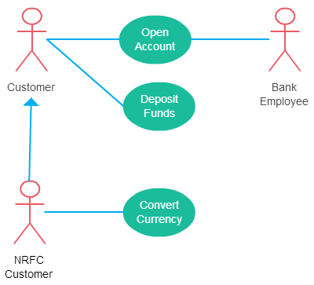
Generalization of an Actor
Generalization of an actor means that one actor can inherit the role of the other actor.
A generalized actor in an use case diagram

Slide 18
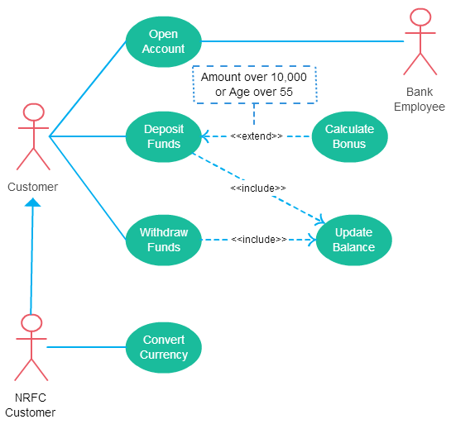
Include Relationship Between Two Use Cases
Include relationship show that the behavior of the included use case is part of the including (base) use case.
The included use case is mandatory and not optional.

Slide 19
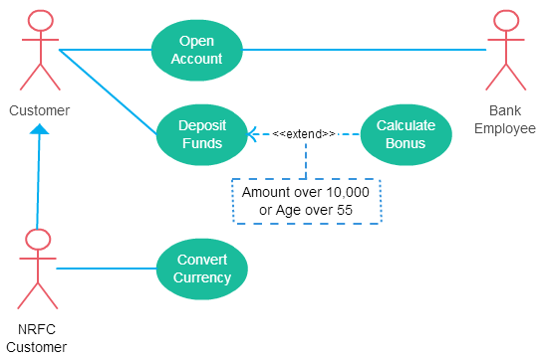
Extend Relationship Between Two Use Cases
The use case is optional and comes after the base use case. It is represented by a dashed arrow in the direction of the base use case with the notation <<extend>>.
Extend relationship in use case diagrams

Slide 20
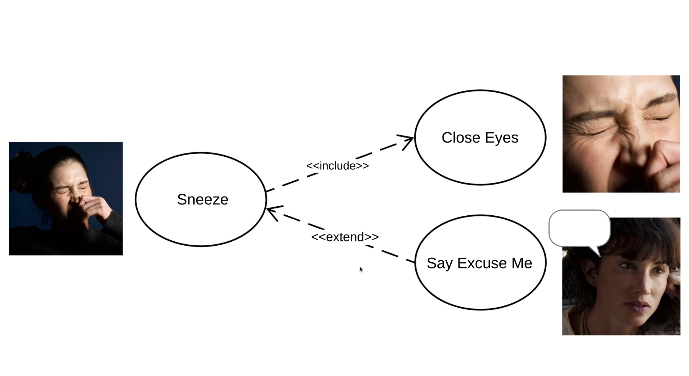
Fig: A simple Example of include and extend relationship.

Slide 21
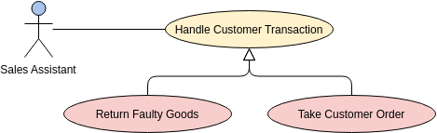
Generalization of a use case
Generalization is a relationship between two entities such that one entity (child) inherits the functionality of another entity (parent). It can exist between two actors or two use cases. It is represented by an arrow in the direction of the parent use case or actor.

Slide 22
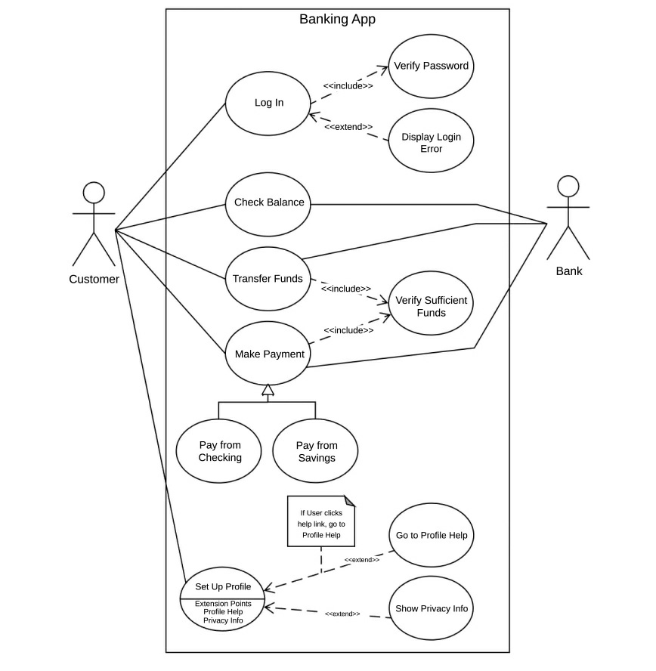
Complete use case diagram of Banking App

Slide 23
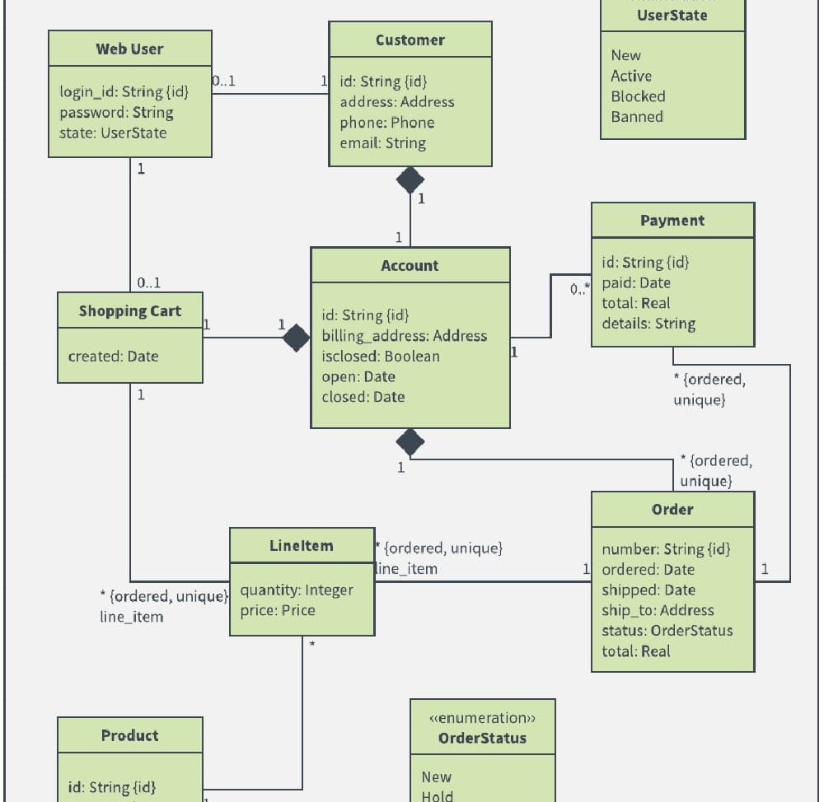
Class diagram

Slide 24
What is Class Diagram?
A class diagram in the Unified Modeling Language (UML) is a type of static structure diagram that describes the structure of a system by showing the system's classes, their attributes, operations (or methods), and the relationships among objects.

Slide 25
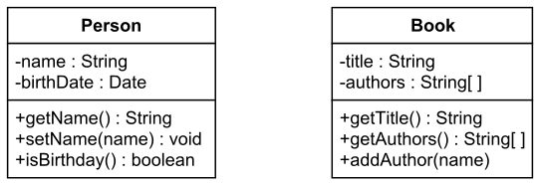
Class Notation
A class notation consists of three parts:
Class Name
The name of the class appears in the first partition.
Class Attributes
Attributes are shown in the second partition.
The attribute type is shown after the colon.
Class Operations (Methods)
Operations are shown in the third partition. They are services the class provides.

Slide 26
Class Relationships
A class may be involved in one or more relationships with other classes. A relationship of the following types..
Generalization
Association
Aggregation
Composition
Dependency

Slide 27
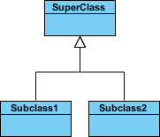
Generalization
SubClass1 and SubClass2 are specializations of Super Class.
A solid line with a hollow arrowhead that point from the child to the parent class
Graphical Representation of generalization

Slide 28
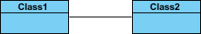
Association
A structural link between two peer classes.
There is an association between Class1 and Class2
A solid line connecting two classes
Association

Slide 29
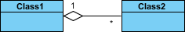
Aggregation
A special type of association. It represents a "part of" relationship.
Class2 is part of Class1.
Many instances (denoted by the *) of Class2 can be associated with Class1.
Objects of Class1 and Class2 have separate lifetimes.
A solid line with an unfilled diamond at the association end connected to the class of composite
Aggregation

Slide 30
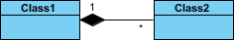
Composition
A special type of aggregation where parts are destroyed when the whole is destroyed.
Objects of Class2 live and die with Class1.
Class2 cannot stand by itself.
A solid line with a filled diamond at the association connected to the class of composite
Composition

Slide 31
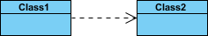
Dependency
Exists between two classes if the changes to the definition of one may cause changes to the other (but not the other way around).
Class1 depends on Class2
A dashed line with an open arrow

Slide 32
Visibility of Class attributes and Operations
In object-oriented design, there is a notation of visibility for attributes and operations. UML identifies four types of visibility: public, protected, private, and package.
The +, -, # and ~ symbols before an attribute and operation name in a class denote the visibility of the attribute and operation.
+ denotes public attributes or operations
- denotes private attributes or operations
# denotes protected attributes or operations
~ denotes package attributes or operations

Slide 33
Multiplicity
How many objects of each class take part in the relationships and multiplicity can be expressed as:
Exactly one - 1
Zero or one - 0..1
Many - 0..* or *
One or more - 1..*
Exact Number - e.g. 3..4 or 6
Or a complex relationship - e.g. 0..1, 3..4, 6.* would mean any number of objects other than 2 or 5

Slide 34
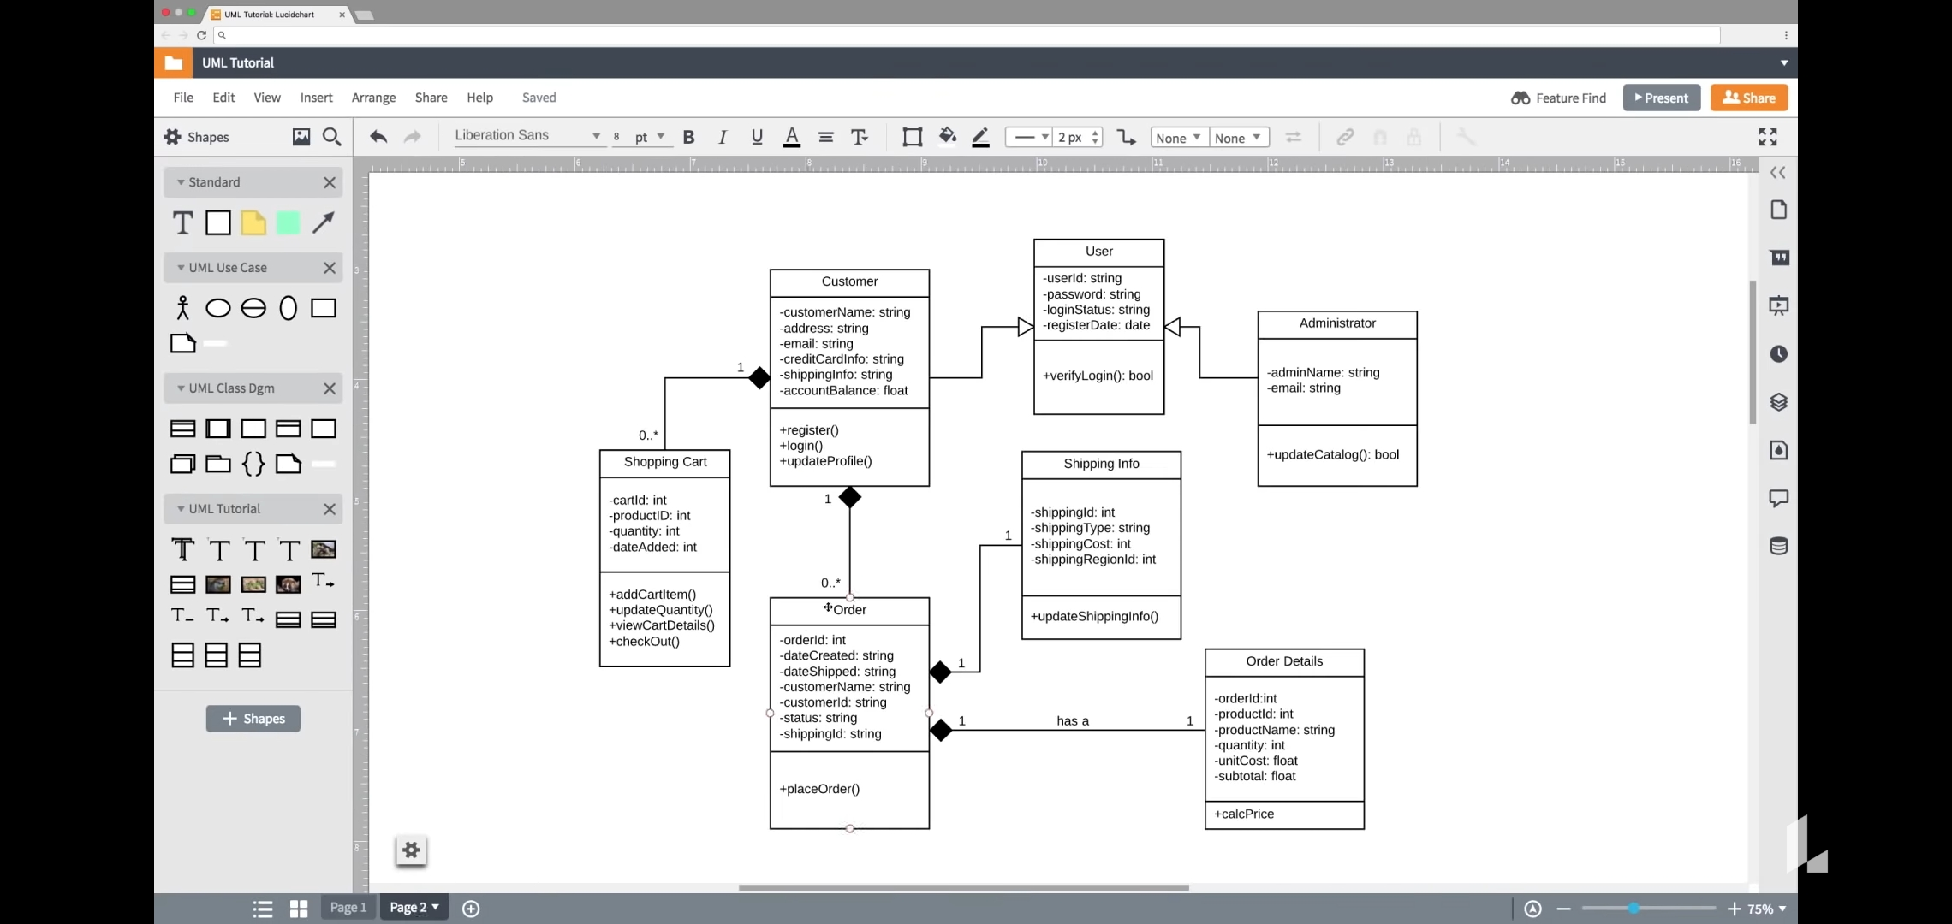
Class Diagram

Slide 35

State Diagram
A state diagram is the graphical representation of a state machine that is used to represent the condition of the system or parts of the system at finite instances of time.

Slide 36
Components
State:- state is the status of the system at a particular time.
Event:-It is a internal or external trigger which cause the system to change its state.
Transition:- Change in state is meant by transition. A transition occur between two status from the source state to the destination.

Slide 37
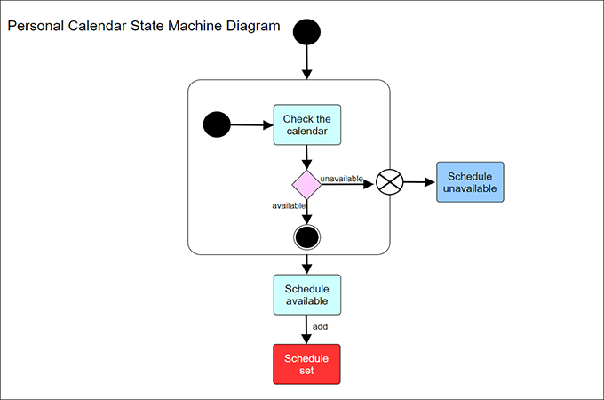
Initial state- Usually marked by a solid black circle, this represents the initial state of a system or a class.
Middle states- These are portrayed as boxes with rounded corners. There may be one or two horizontal lines through a box, dividing it into stacked sections. In that case, the upper section contains the name of the state, the middle section (if any) contains the state variables, and the lower section contains the actions performed in that state. If there are no horizontal lines through a box, only the name of the state is written inside it.
Transitions- External straight lines, each with an arrow at one end, connect various pairs of boxes. These lines define the transitions between states.
Final state- The final state is portrayed as a large black dot with a circle around it

Slide 38
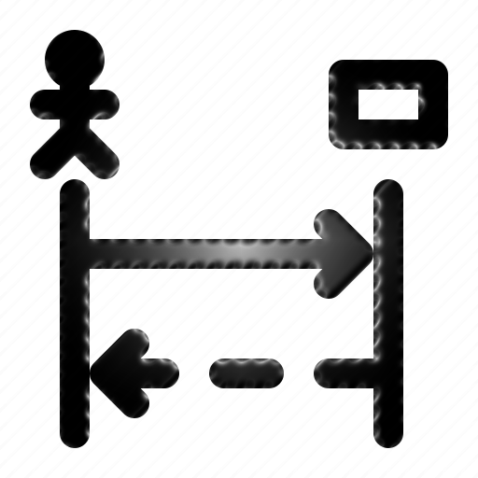
Sequence Modelling
Sequence Diagram is a special type of INTERACTION diagram. They are Used to capture the DYNAMIC BEHAVIOR of the system. They are type of UML Diagram that shows how the objects in a system or classes within code Interact with each other. In other words, They show Sequence of events.

Slide 39



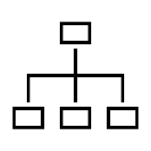

Purpose of Sequence Diagram
To capture dynamic behavior of a system.
To describe the message flow in the system.
To describe structural organization of the objects.
To describe interaction among objects.

Slide 40

Actor
Objects
Lifelines
Messages
Condition Mark
Activation Bar
Components

Slide 41

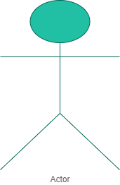
Actor
Actor is the user, which is represented by the stick figure. Actors are always outside the scope of the system.

Slide 42
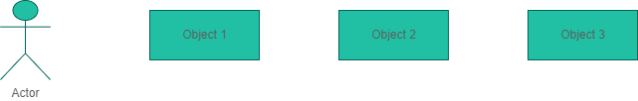
Objects
Objects are model elements that represent instances of a class or of classes.

Slide 43
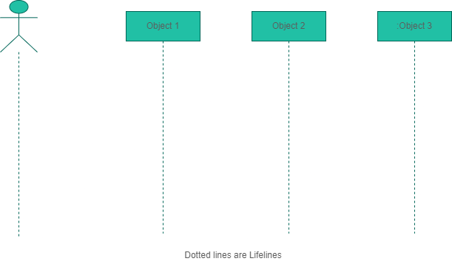
Lifelines
An individual participant in the sequence diagram is represented by a lifeline. It is positioned at the top of the diagram. It shows the presence of the objects in the system.

Slide 44
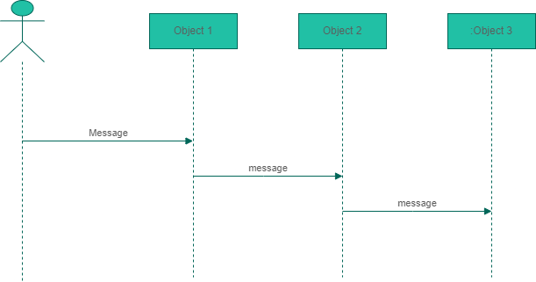
Messages
The messages depict the interaction between the objects and are represented by arrows. They are in the sequential order on the lifeline.

Slide 45
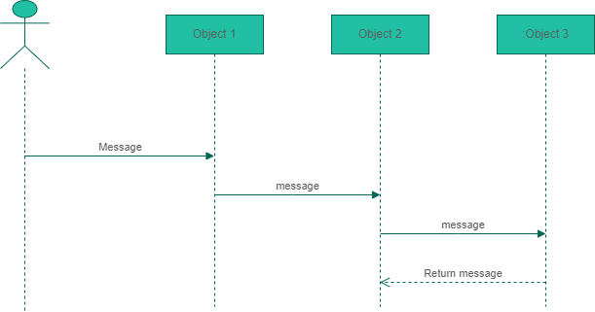
Return messages
Return Message defines a particular communication between the lifelines of interaction that represent the flow of information from the receiver of the corresponding caller message.

Slide 46
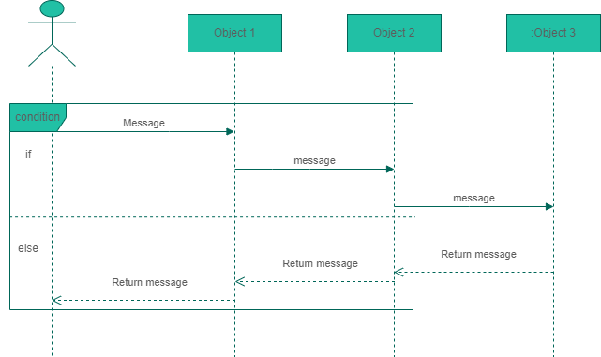
Condition Mark
A condition mark (or state mark) is displayed on an instance line. A condition mark shows that the object has reached a certain condition or is in a certain state.

Slide 47
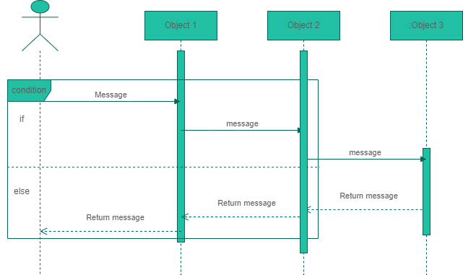
Activation Bar
Activation is represented by a thin rectangle on the lifeline. It describes that time period in which an operation is performed by an element.

Slide 48
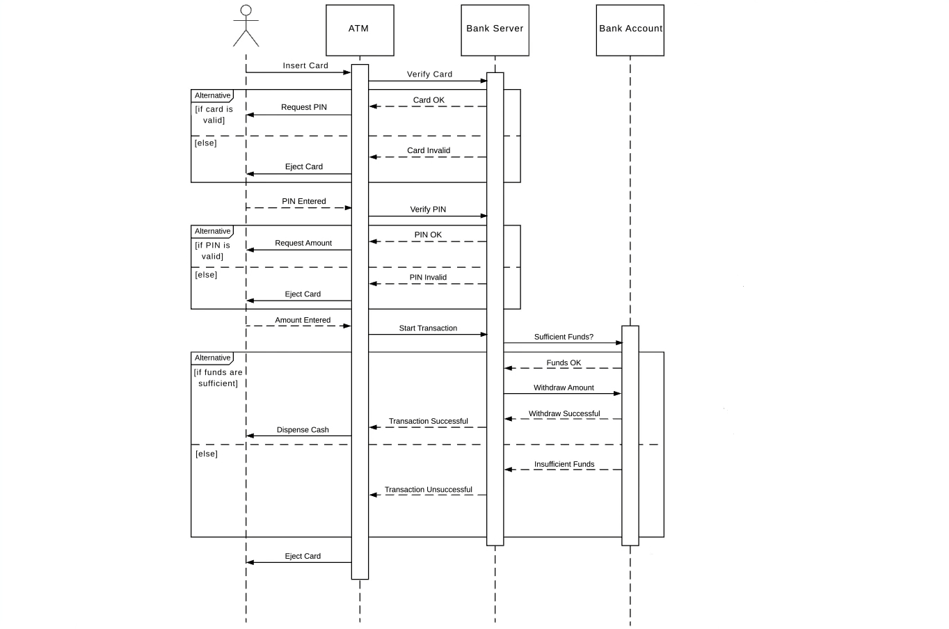
Fig: Sequence Diagram of ATM

